Slide 1
Intersection of 2 Planes

Slide 2
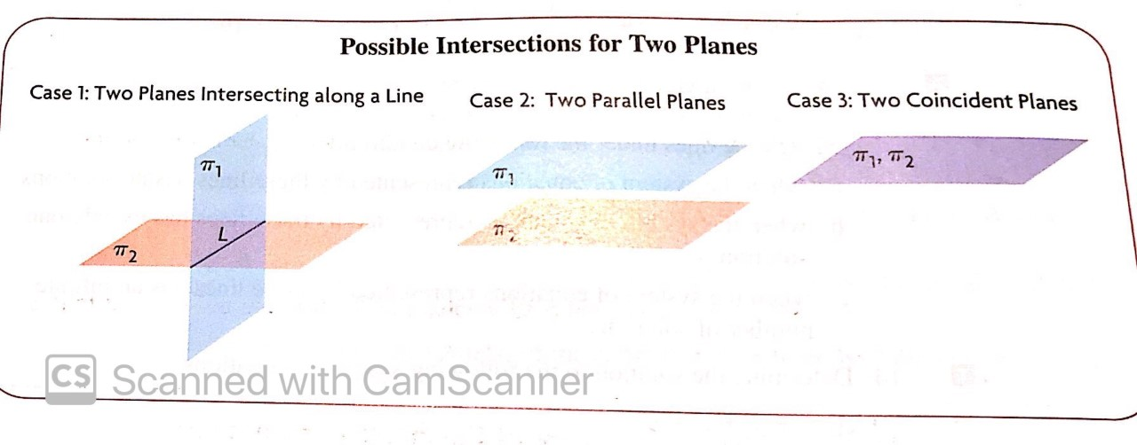
There are 3 cases when it comes to the intersection of 2 planes
Case 1: Two planes intersect along a line (infinite points of intersection)
Case 2: Two parallel planes (no points of intersection)
Case 3: Two coincident planes (infinite points of intersection)

Slide 3
It is not possible for two planes to intersect at only one point. There are either zero points of intersection (like in case 2) or there are an infinite number of points of intersection (a line like in case 1 or a plane like in case 3)

Slide 4
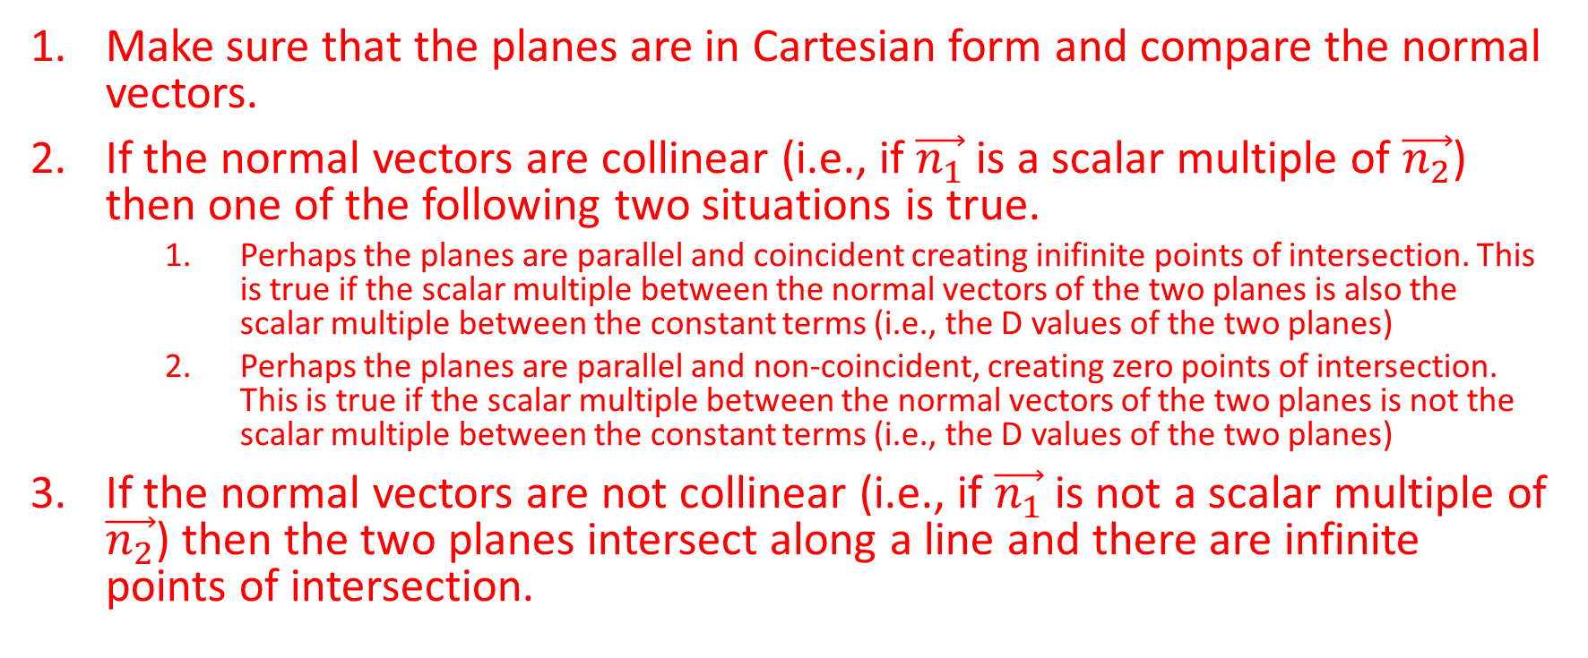
Method for Determining the Intersection of Two Planes
Make sure that the planes are in Cartesian form and compare the normal vectors.
If the normal vectors are collinear (i.e., if $\vec{n_{1}}$is a scalar multiple of $\vec{n_{2}}$) then one of the following two situations is true.
Perhaps the planes are parallel and coincident creating inifinite points of intersection. This is true if the scalar multiple between the normal vectors of the two planes is also the scalar multiple between the constant terms (i.e., the D values of the two planes)
Perhaps the planes are parallel and non-coincident, creating zero points of intersection. This is true if the scalar multiple between the normal vectors of the two planes is not the scalar multiple between the constant terms (i.e., the D values of the two planes)
If the normal vectors are not collinear (i.e., if $\vec{n_{1}}$is not a scalar multiple of $\vec{n_{2}}$) then the two planes intersect along a line and there are infinite points of intersection.

Slide 5
If Two Planes are non-Parallel
Make a matrix with the Cartesian equations of the planes
Use elementary row operations to get a zero in one of the three left-hand columns of one of the rows
Using that row, sub in a value for one of the remaining columns, and determine the value for the other column.
Then, sub both of those values in to the other row to determine a value for the third column. You now have a position vector.
The direction vector is the cross product of the normal vectors of the planes.
You can now state the equation of the line in vector form.

Slide 6

Example
Determine whether the following planes intersect. If they do intersect, state how they intersect, and include the equation of the line of intersection if necessary.
$π_{1}:2x−3y+7z−25=0$ and $π_{2}:4x−6y+14z−50=0$

Slide 7
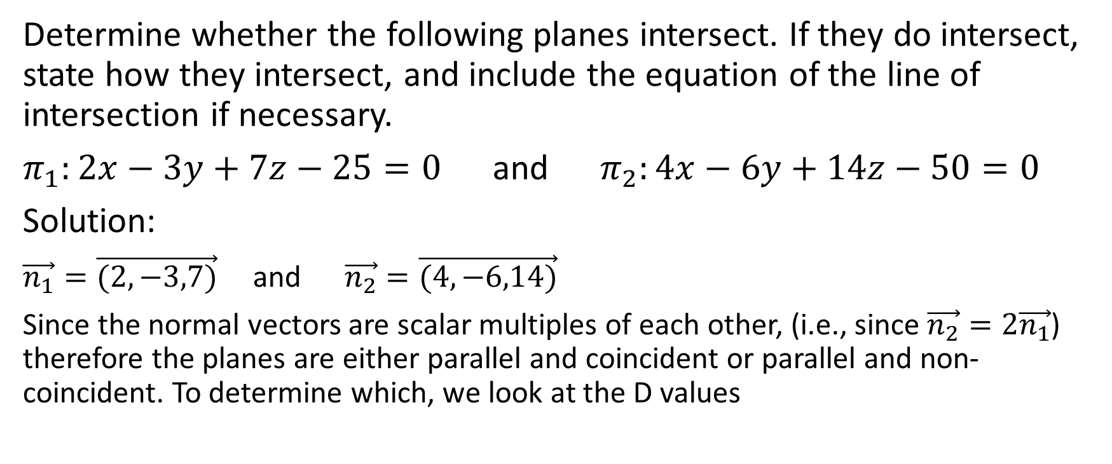
Determine whether the following planes intersect. If they do intersect, state how they intersect, and include the equation of the line of intersection if necessary.
$π_{1}:2x−3y+7z−25=0$ and $π_{2}:4x−6y+14z−50=0$
Solution:
$\vec{n_{1}}=\vec{(2,−3,7)}$ and $\vec{n_{2}}=\vec{(4,−6,14)}$
Since the normal vectors are scalar multiples of each other, (i.e., since $\vec{n_{2}}=2\vec{n_{1}}$) therefore the planes are either parallel and coincident or parallel and non-coincident. To determine which, we look at the D values

Slide 8
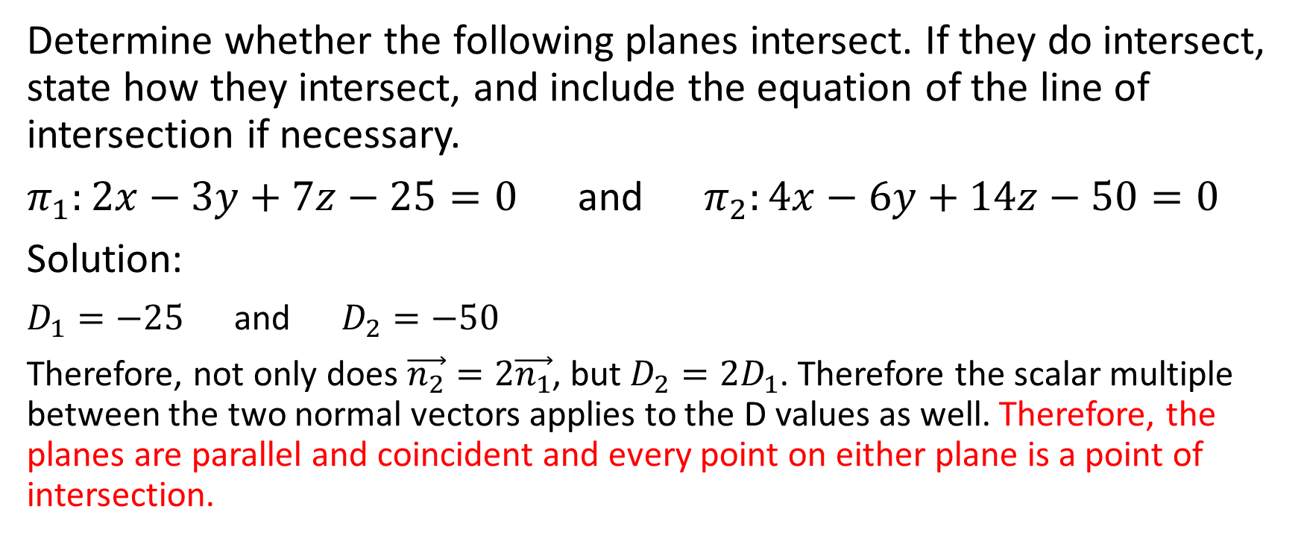
Determine whether the following planes intersect. If they do intersect, state how they intersect, and include the equation of the line of intersection if necessary.
$π_{1}:2x−3y+7z−25=0$ and $π_{2}:4x−6y+14z−50=0$
Solution:
$D_{1}=−25$ and $D_{2}=−50$
Therefore, not only does $\vec{n_{2}}=2\vec{n_{1}}$, but $D_{2}=2D_{1}$. Therefore the scalar multiple between the two normal vectors applies to the D values as well. Therefore, the planes are parallel and coincident and every point on either plane is a point of intersection.

Slide 9

Example
Determine whether the following planes intersect. If they do intersect, state how they intersect, and include the equation of the line of intersection if necessary.
$π_{1}:9x−y+4z−16=0$ and $π_{2}:−18x+2y−8z+8=0$

Slide 10
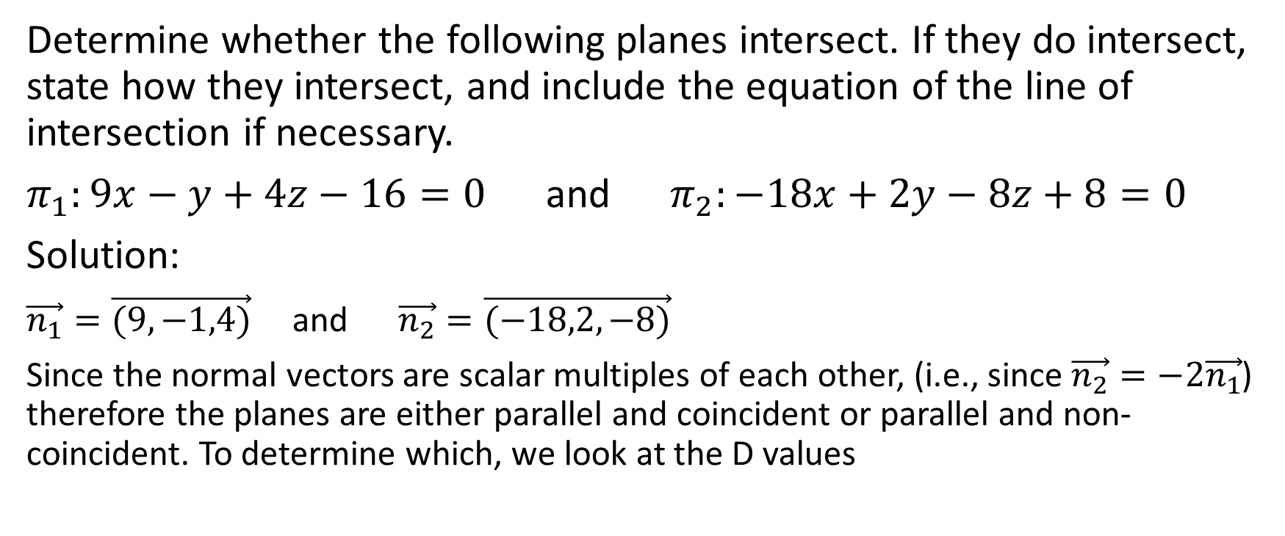
Determine whether the following planes intersect. If they do intersect, state how they intersect, and include the equation of the line of intersection if necessary.
$π_{1}:9x−y+4z−16=0$ and $π_{2}:−18x+2y−8z+8=0$
Solution:
$\vec{n_{1}}=\vec{(9,−1,4)}$ and $\vec{n_{2}}=\vec{(−18,2,−8)}$
Since the normal vectors are scalar multiples of each other, (i.e., since $\vec{n_{2}}=−2\vec{n_{1}}$) therefore the planes are either parallel and coincident or parallel and non-coincident. To determine which, we look at the D values

Slide 11
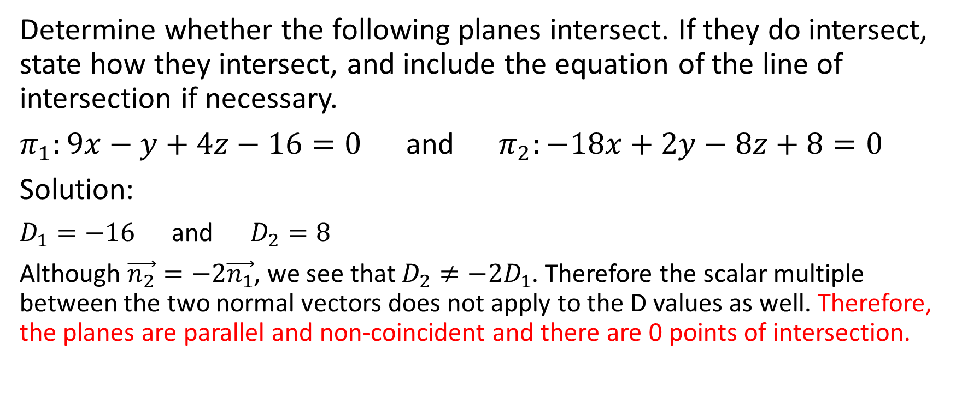
Determine whether the following planes intersect. If they do intersect, state how they intersect, and include the equation of the line of intersection if necessary.
$π_{1}:9x−y+4z−16=0$ and $π_{2}:−18x+2y−8z+8=0$
Solution:
$D_{1}=−16$ and $D_{2}=8$
Although $\vec{n_{2}}=−2\vec{n_{1}}$, we see that $D_{2}≠−2D_{1}$. Therefore the scalar multiple between the two normal vectors does not apply to the D values as well. Therefore, the planes are parallel and non-coincident and there are 0 points of intersection.

Slide 12

Example
Determine whether the following planes intersect. If they do intersect, state how they intersect, and include the equation of the line of intersection if necessary.
$π_{1}:2x−y+3z−6=0$ and $π_{2}:3x+2y−z+18=0$

Slide 13
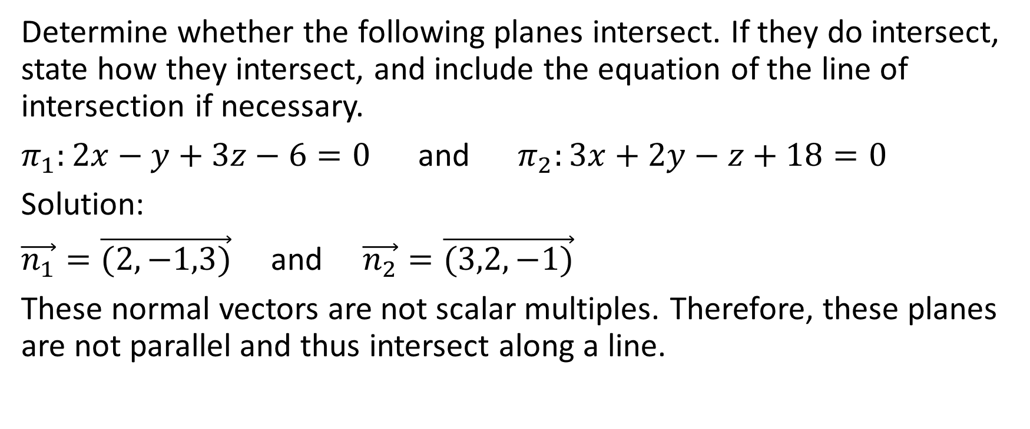
Determine whether the following planes intersect. If they do intersect, state how they intersect, and include the equation of the line of intersection if necessary.
$π_{1}:2x−y+3z−6=0$ and $π_{2}:3x+2y−z+18=0$
Solution:
$\vec{n_{1}}=\vec{(2,−1,3)}$ and $\vec{n_{2}}=\vec{(3,2,−1)}$
These normal vectors are not scalar multiples. Therefore, these planes are not parallel and thus intersect along a line.

Slide 14
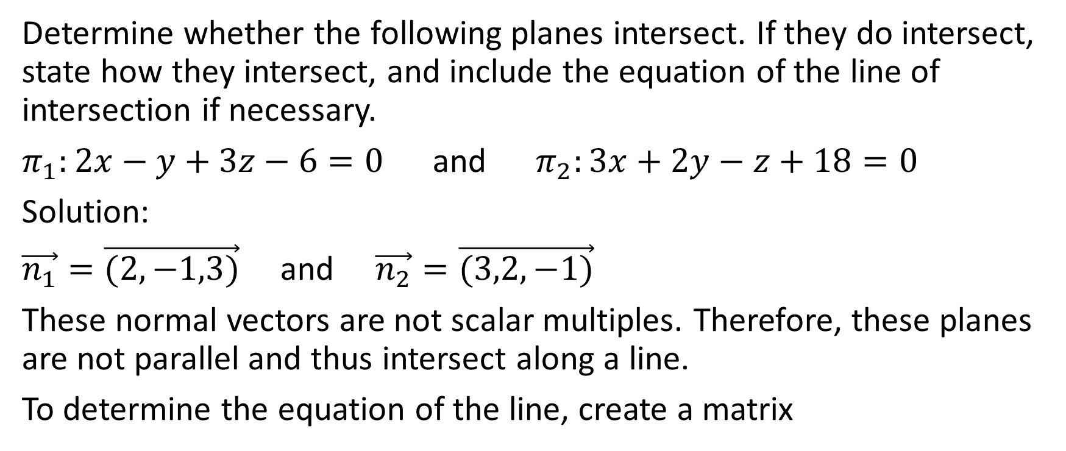
Determine whether the following planes intersect. If they do intersect, state how they intersect, and include the equation of the line of intersection if necessary.
$π_{1}:2x−y+3z−6=0$ and $π_{2}:3x+2y−z+18=0$
Solution:
$\vec{n_{1}}=\vec{(2,−1,3)}$ and $\vec{n_{2}}=\vec{(3,2,−1)}$
These normal vectors are not scalar multiples. Therefore, these planes are not parallel and thus intersect along a line.
To determine the equation of the line, create a matrix

Slide 15
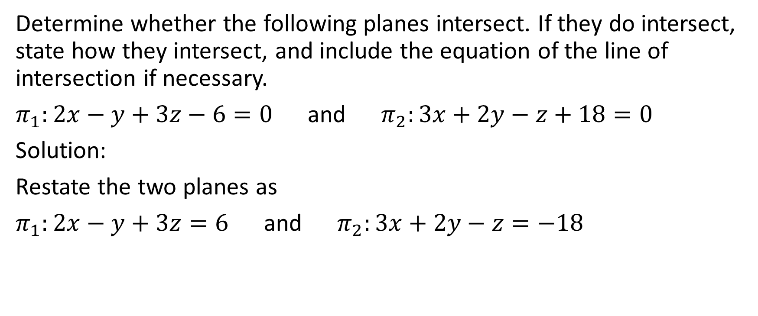
Determine whether the following planes intersect. If they do intersect, state how they intersect, and include the equation of the line of intersection if necessary.
$π_{1}:2x−y+3z−6=0$ and $π_{2}:3x+2y−z+18=0$
Solution:
Restate the two planes as
$π_{1}:2x−y+3z=6$ and $π_{2}:3x+2y−z=−18$

Slide 16
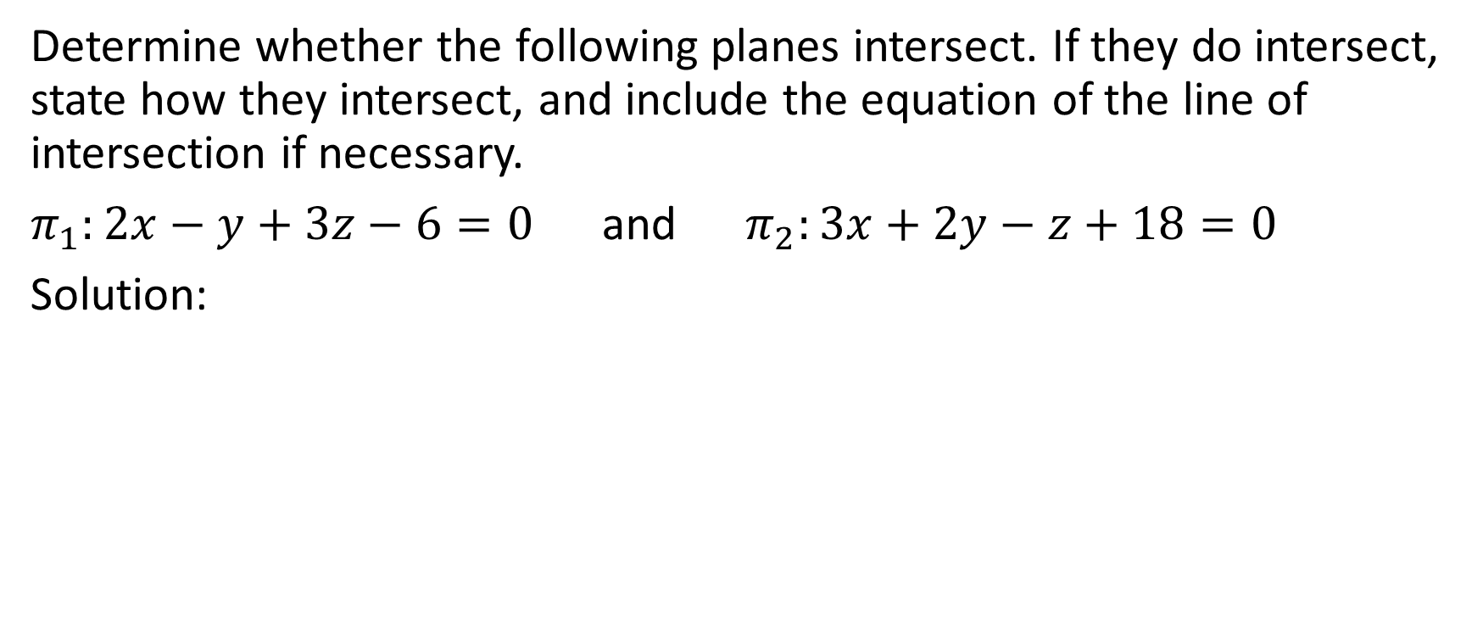


Determine whether the following planes intersect. If they do intersect, state how they intersect, and include the equation of the line of intersection if necessary.
$π_{1}:2x−y+3z−6=0$ and $π_{2}:3x+2y−z+18=0$
Solution:

Slide 17
Determine whether the following planes intersect. If they do intersect, state how they intersect, and include the equation of the line of intersection if necessary.
$π_{1}:2x−y+3z−6=0$ and $π_{2}:3x+2y−z+18=0$
Solution:
Get an entry of 0 in either the x-column or the y-column or the z-column of the last row.

Slide 18
Determine whether the following planes intersect. If they do intersect, state how they intersect, and include the equation of the line of intersection if necessary.
$π_{1}:2x−y+3z−6=0$ and $π_{2}:3x+2y−z+18=0$
Solution:
Get an entry of 0 in either the x-column or the y-column or the z-column of the last row.
Let’s get an entry of 0 in the x-column of the 2nd row by multiplying row 1 by 3 and multiplying row 2 by 2 and then subtracting

Slide 19

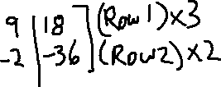
Determine whether the following planes intersect. If they do intersect, state how they intersect, and include the equation of the line of intersection if necessary.
$π_{1}:2x−y+3z−6=0$ and $π_{2}:3x+2y−z+18=0$
Solution:

Slide 20


Determine whether the following planes intersect. If they do intersect, state how they intersect, and include the equation of the line of intersection if necessary.
$π_{1}:2x−y+3z−6=0$ and $π_{2}:3x+2y−z+18=0$
Solution:

Slide 21


Determine whether the following planes intersect. If they do intersect, state how they intersect, and include the equation of the line of intersection if necessary.
$π_{1}:2x−y+3z−6=0$ and $π_{2}:3x+2y−z+18=0$
Solution:

Slide 22
Determine whether the following planes intersect. If they do intersect, state how they intersect, and include the equation of the line of intersection if necessary.
$π_{1}:2x−y+3z−6=0$ and $π_{2}:3x+2y−z+18=0$
Solution:
To get the equation of a line, we want a point on the line. We can get a point on the line by focusing on the last row. 0x – 7y + 11z = 54

Slide 23
Determine whether the following planes intersect. If they do intersect, state how they intersect, and include the equation of the line of intersection if necessary.
$π_{1}:2x−y+3z−6=0$ and $π_{2}:3x+2y−z+18=0$
Solution:
To get the equation of a line, we want a point on the line. We can get a point on the line by focusing on the last row. 0x – 7y + 11z = 54
We can assign a value to either y or to z and then solve for the other one. If we let y = 0, then 11z = 54 and z=54/11. This is perfectly valid and correct, but if we try a bit, we can usually find integer values of y and z that will satisfy the last row and thus make a slightly nicer looking equation.

Slide 24
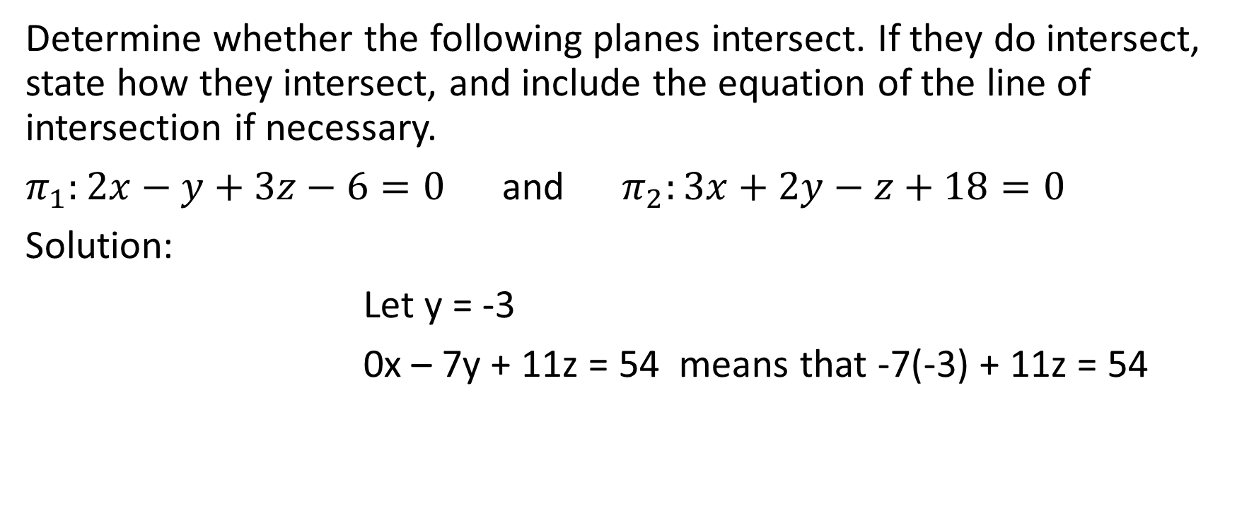
Determine whether the following planes intersect. If they do intersect, state how they intersect, and include the equation of the line of intersection if necessary.
$π_{1}:2x−y+3z−6=0$ and $π_{2}:3x+2y−z+18=0$
Solution:
Let y = -3
0x – 7y + 11z = 54 means that -7(-3) + 11z = 54

Slide 25
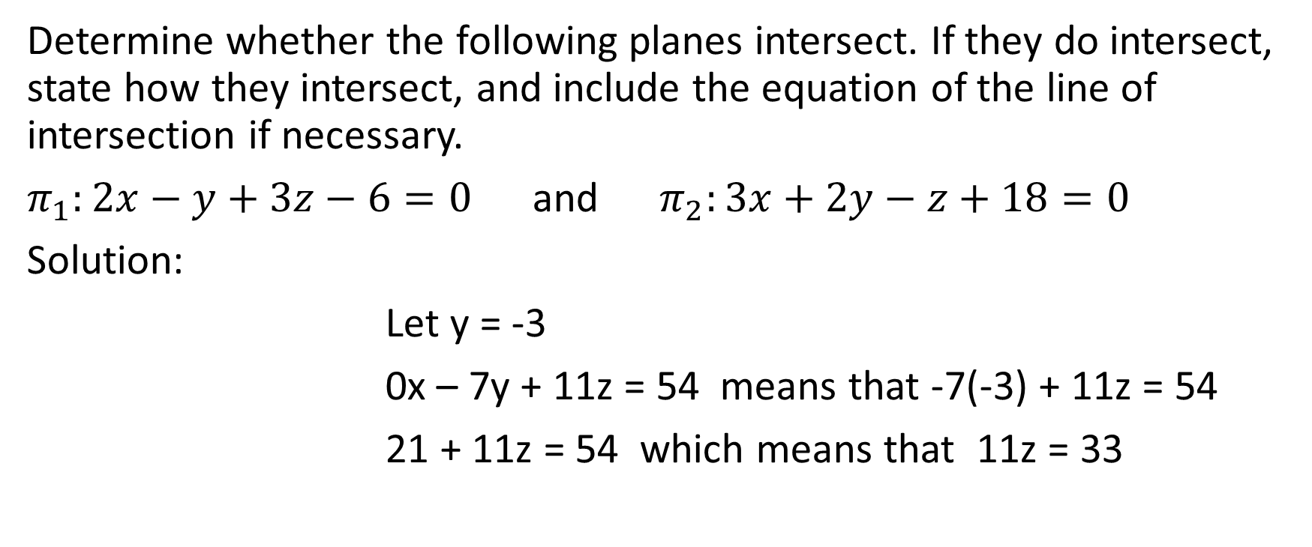
Determine whether the following planes intersect. If they do intersect, state how they intersect, and include the equation of the line of intersection if necessary.
$π_{1}:2x−y+3z−6=0$ and $π_{2}:3x+2y−z+18=0$
Solution:
Let y = -3
0x – 7y + 11z = 54 means that -7(-3) + 11z = 54
21 + 11z = 54 which means that 11z = 33

Slide 26
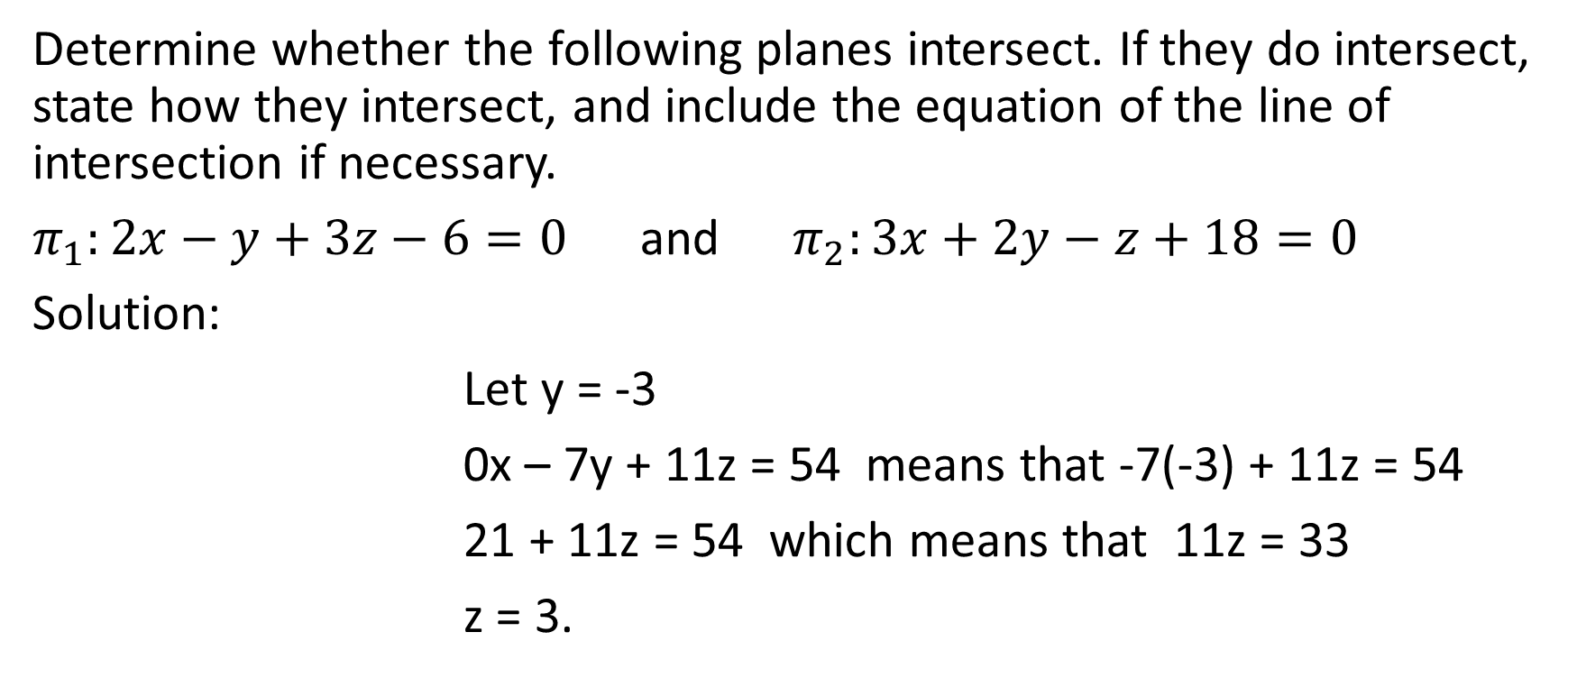
Determine whether the following planes intersect. If they do intersect, state how they intersect, and include the equation of the line of intersection if necessary.
$π_{1}:2x−y+3z−6=0$ and $π_{2}:3x+2y−z+18=0$
Solution:
Let y = -3
0x – 7y + 11z = 54 means that -7(-3) + 11z = 54
21 + 11z = 54 which means that 11z = 33
z = 3.

Slide 27
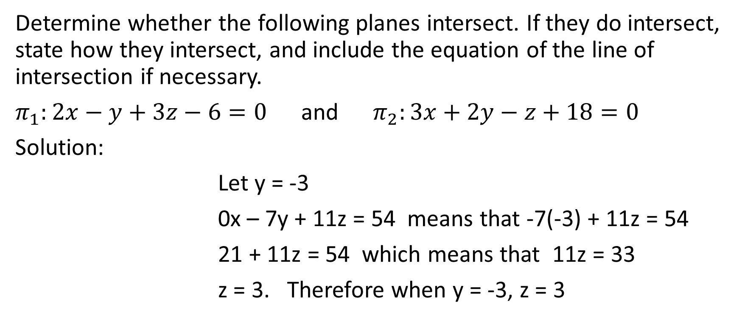
Determine whether the following planes intersect. If they do intersect, state how they intersect, and include the equation of the line of intersection if necessary.
$π_{1}:2x−y+3z−6=0$ and $π_{2}:3x+2y−z+18=0$
Solution:
Let y = -3
0x – 7y + 11z = 54 means that -7(-3) + 11z = 54
21 + 11z = 54 which means that 11z = 33
z = 3. Therefore when y = -3, z = 3

Slide 28
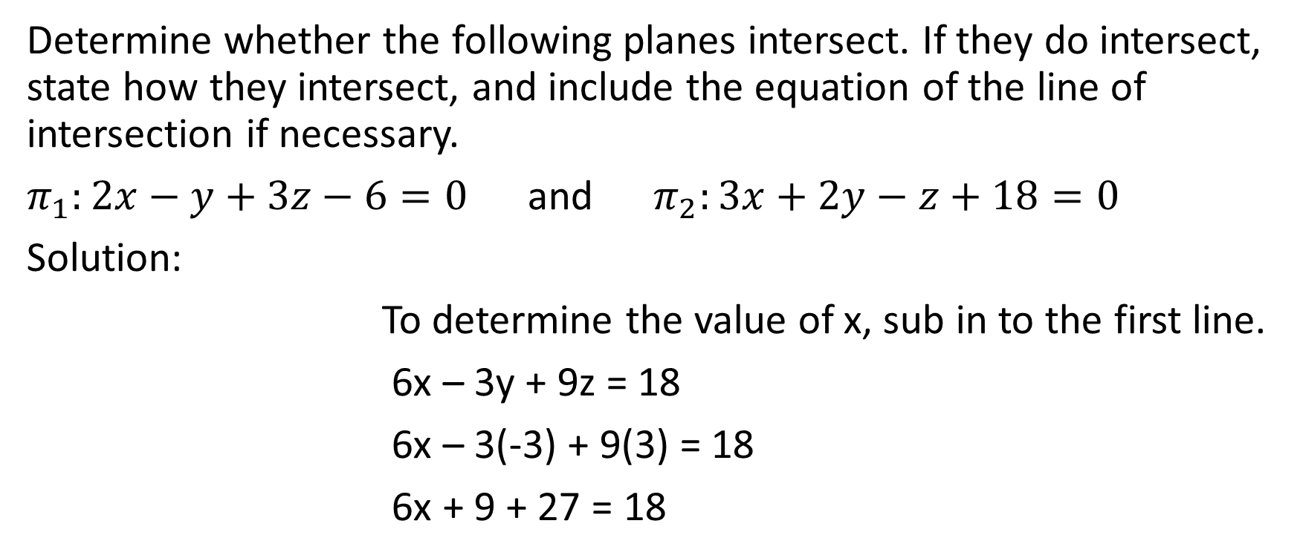
Determine whether the following planes intersect. If they do intersect, state how they intersect, and include the equation of the line of intersection if necessary.
$π_{1}:2x−y+3z−6=0$ and $π_{2}:3x+2y−z+18=0$
Solution:
To determine the value of x, sub in to the first line.
6x – 3y + 9z = 18
6x – 3(-3) + 9(3) = 18
6x + 9 + 27 = 18

Slide 29
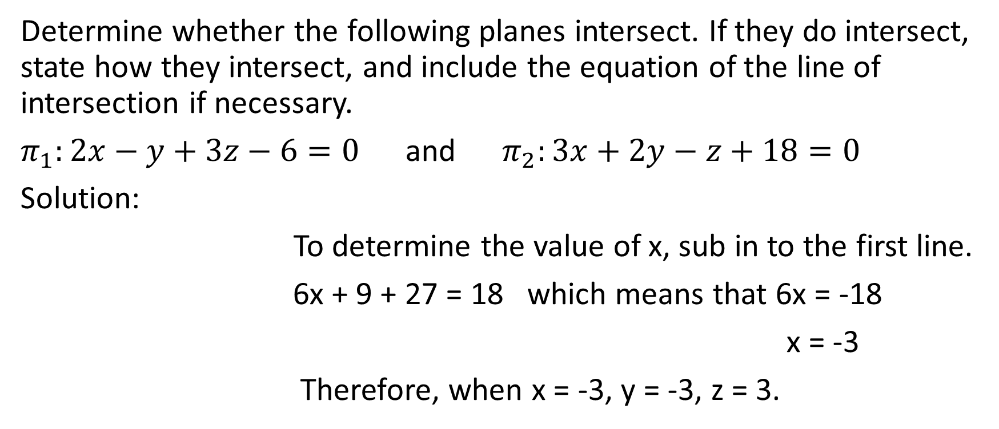
Determine whether the following planes intersect. If they do intersect, state how they intersect, and include the equation of the line of intersection if necessary.
$π_{1}:2x−y+3z−6=0$ and $π_{2}:3x+2y−z+18=0$
Solution:
To determine the value of x, sub in to the first line.
6x + 9 + 27 = 18 which means that 6x = -18
x = -3
Therefore, when x = -3, y = -3, z = 3.

Slide 30
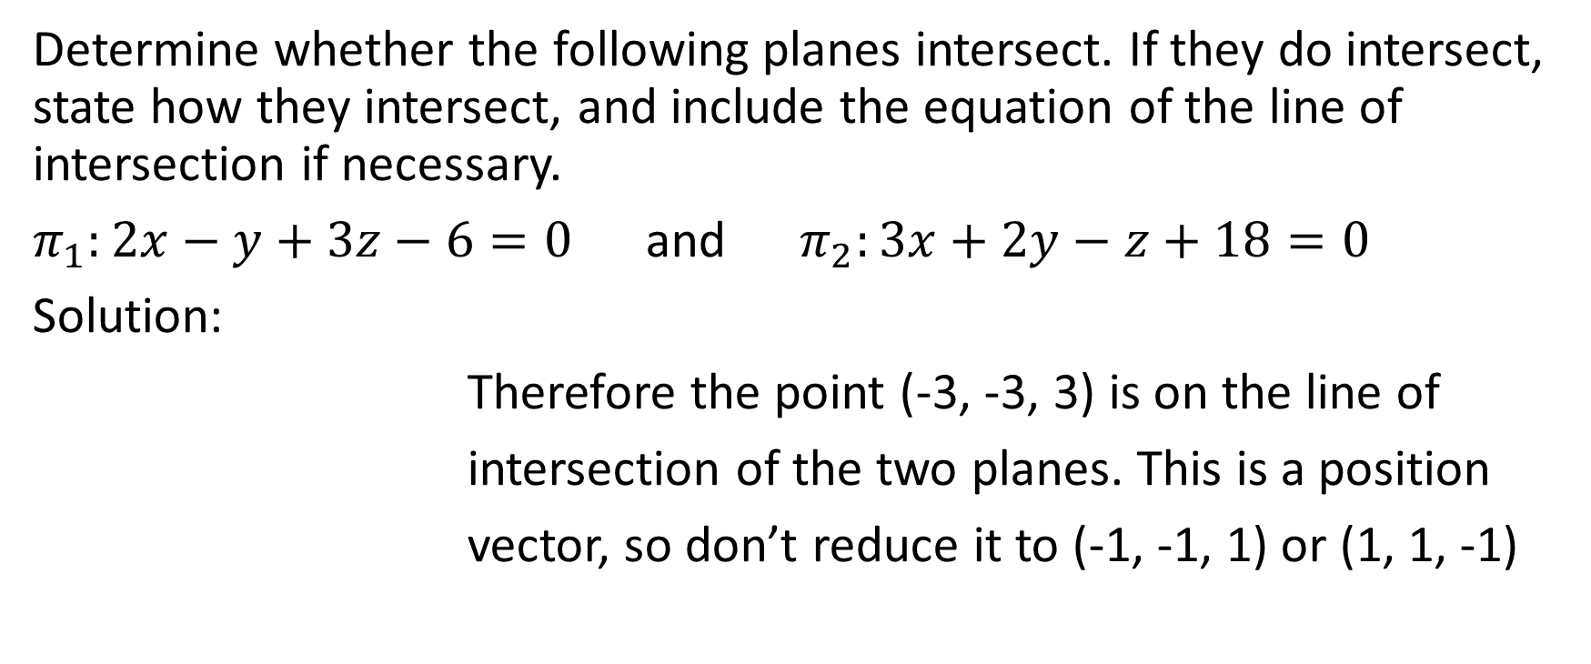
Determine whether the following planes intersect. If they do intersect, state how they intersect, and include the equation of the line of intersection if necessary.
$π_{1}:2x−y+3z−6=0$ and $π_{2}:3x+2y−z+18=0$
Solution:
Therefore the point (-3, -3, 3) is on the line of
intersection of the two planes. This is a position
vector, so don’t reduce it to (-1, -1, 1) or (1, 1, -1)

Slide 31
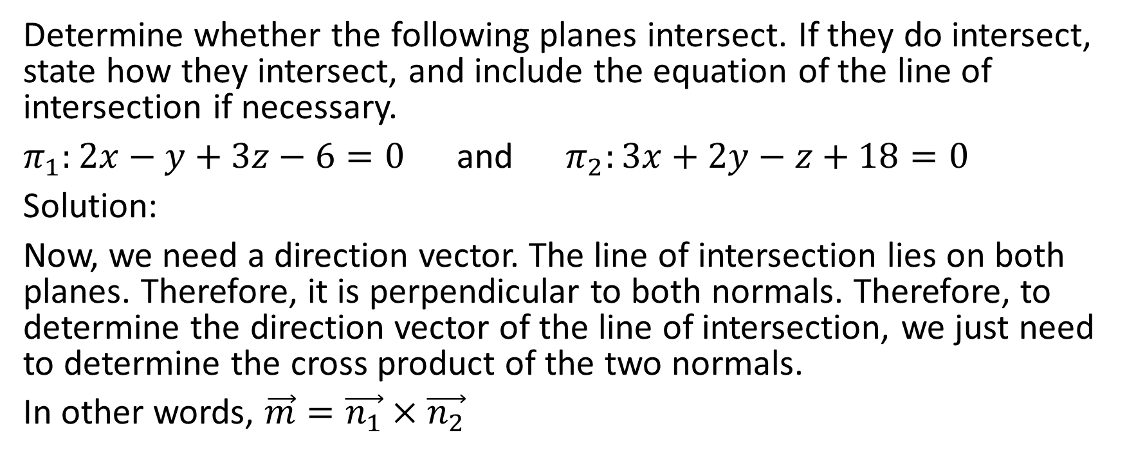
Determine whether the following planes intersect. If they do intersect, state how they intersect, and include the equation of the line of intersection if necessary.
$π_{1}:2x−y+3z−6=0$ and $π_{2}:3x+2y−z+18=0$
Solution:
Now, we need a direction vector. The line of intersection lies on both planes. Therefore, it is perpendicular to both normals. Therefore, to determine the direction vector of the line of intersection, we just need to determine the cross product of the two normals.
In other words, $\vec{m}=\vec{n_{1}}×\vec{n_{2}}$

Slide 32


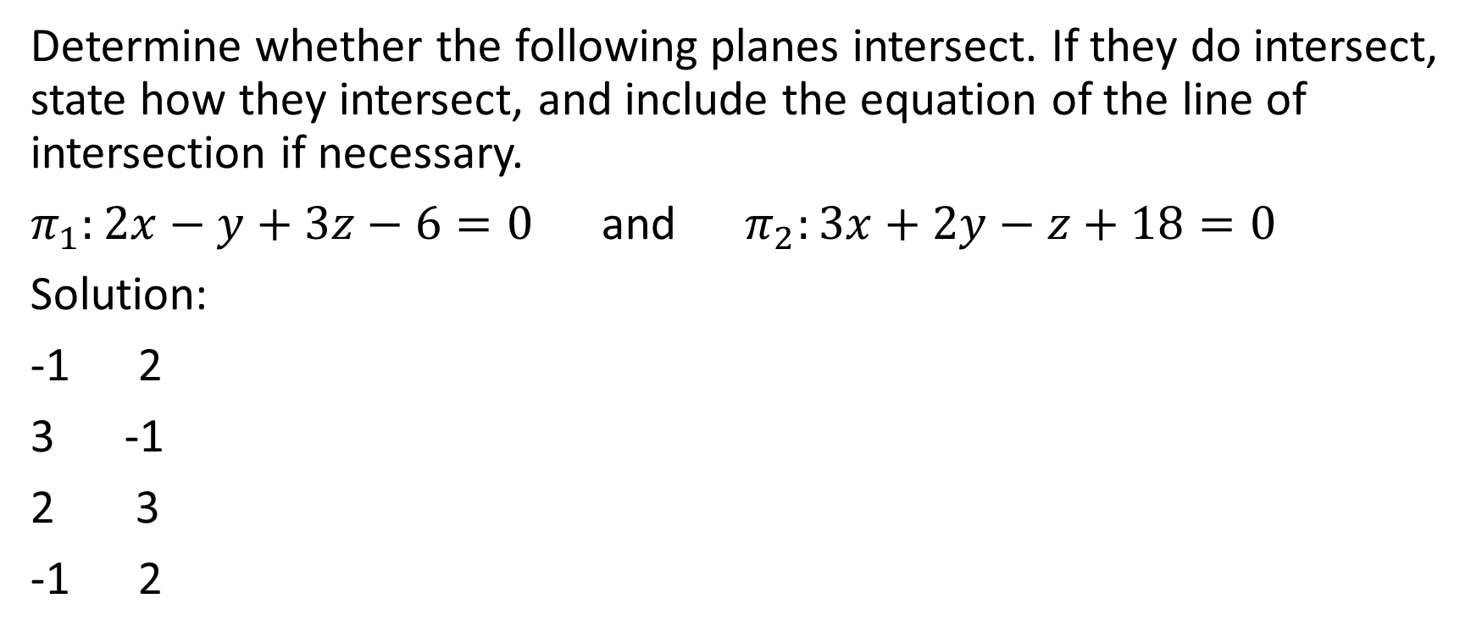


Determine whether the following planes intersect. If they do intersect, state how they intersect, and include the equation of the line of intersection if necessary.
$π_{1}:2x−y+3z−6=0$ and $π_{2}:3x+2y−z+18=0$
Solution:
-1 2
-1
3
-1 2

Slide 33
Determine whether the following planes intersect. If they do intersect, state how they intersect, and include the equation of the line of intersection if necessary.
$π_{1}:2x−y+3z−6=0$ and $π_{2}:3x+2y−z+18=0$
Solution:
-1 2
-1
3
-1 2
Therefore, we could say that the direction vector is (-5, 11, 7). However, it’s a convention in math that the first non-zero component of a direction vector is positive, therefore we will say that the direction vector is (5, -11, -7)

Slide 34
Determine whether the following planes intersect. If they do intersect, state how they intersect, and include the equation of the line of intersection if necessary.
$π_{1}:2x−y+3z−6=0$ and $π_{2}:3x+2y−z+18=0$
Solution:
-1 2
-1
3
-1 2
We’ve established that the position vector is (-3, -3, 3) and the direction vector is (5, -11, -7)

Slide 35
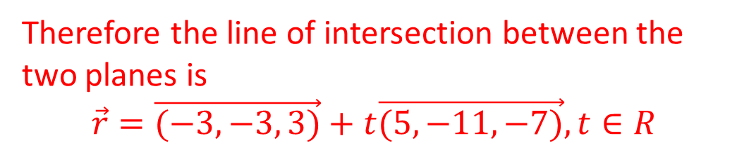
Determine whether the following planes intersect. If they do intersect, state how they intersect, and include the equation of the line of intersection if necessary.
$π_{1}:2x−y+3z−6=0$ and $π_{2}:3x+2y−z+18=0$
Solution:
-1 2
-1
3
-1 2
Therefore the line of intersection between the two planes is
$$\vec{r}=\vec{(−3, −3, 3)}+t\vec{(5,−11,−7)},t∈R$$

